Slide 1


Full Stack Web Development
LARAVEL
UNIT-V

Slide 2

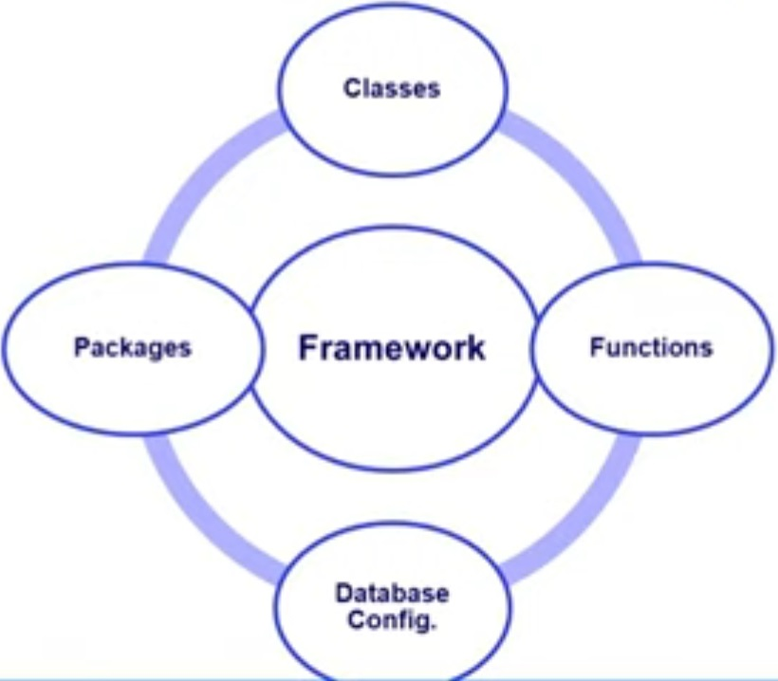
Framework
A Framework or software framework is a platform for developing software application.
Basically, its simplified our work and reduced the amount of code by providing some ready made functionality.

Slide 3
LARAVEL
LARAVEL is a free open-source PHP based web framework.
It has a very rich set of features which will boost the speed of Web Development.
If you familiar with Core PHP and Advanced PHP, Laravel will make your task easier.
It will save a lot time if you are planning to develop a website from scratch.
Laravel follows the model–view–controller (MVC) architectural pattern.
Laravel offers a robust set of tools and an application architecture that incorporates many of the best features of frameworks like CodeIgniter, Yii, ASP.NET MVC, Ruby on Rails, Sinatra, and others.
Taylor Otwell developed Laravel in July 2011, and it was released more than five years after the release of the Codeigniter framework.
Laravel is one of the most popular PHP frameworks after Codeigniter.

Slide 4
Laravel – Features
Open Source
Its free and Large community support
MVC
Laravel uses the MVC model
Model : A model is a class that deals with the Data (Database).
View : A view is a class that deals with an HTML. (User Interface)
Controller : A controller is the middle-man that deals with both model and view.
Blade Templating Engine
Easy to use and more powerful.
It helps reuse common parts like header, footer, and menus without repeating code.
It also allows the use of plain PHP code in Blade templating engine files.
Blade Template Engine file has .blade.php extension.
Artisan
Artisan is the command line tool.
We can create controllers, models, migrations and many more using simple commands.

Slide 5
Composer
Composer is a tool for dependency management in PHP.
Third party libraries can be installed easily with help of composer.
It will manage (install/update) Library/Packages for you.
Eloquent ORM
Eloquent helps you work with the database using simple PHP instead of complex SQL.
Makes database work easier and cleaner.
Instead of writing SQL queries, you can just write simple code to get data.
Inbuilt Authentication
Laravel contains an inbuilt authentication system, you only need to configure models, views, and controllers to make the application work. No any custom code required.
Laravel already provides login, registration, password reset systems.
Routing
Routing decides which page opens when a user visits a URL.
Laravel makes routing very easy to write and manage.

Slide 6
Configuration Management
Easy Configuration. Laravel provides a consistent approach to handle the configuration in an efficient way.
Intact Security
Laravel has an inbuilt web application security.
It uses "Bcrypt Hashing Algorithm" to generate the password means that the password is saved as an encrypted password in a database, not in the form of a plain text.
Libraries
Laravel is very popular as some Object-oriented libraries, and pre-installed libraries are added in this framework, these pre-installed libraries are not added in other php frameworks.
One of the most popular libraries is an authentication library that contains some useful features such as password reset, monitoring active users, Bcrypt hashing, and CSRF protection.

Slide 7
Environment Setup Laravel
Steps to follow :
Installation of PHP Local Server (WAMP/XAMP)
Installation of Composer
Run Command from command prompt
composer create-project laravel/laravel myproject
This creates a folder named myproject
Goto Project folder
cd myproject
Run Laravel Project
php artisan serve
Open in Browser
http://127.0.0.1:8000

Slide 8
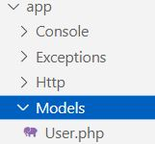
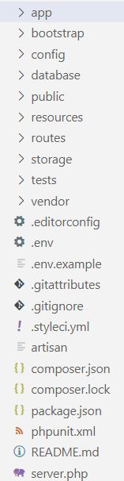
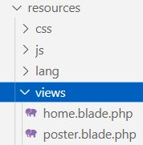
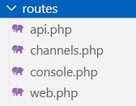
Laravel – Directory Structure
app: This directory contains the core code of the application.
http->Controller – Controller will store here
http->Middleware – Acts as a guard. Define access allowed or not.
bootstrap: This directory contains the application bootstrapping script to Speed up the process
config: This directory contains configuration files of application.
database: This folder contains your database migration and seeds.
public: This is the application’s document root. It starts the Laravel application.
Resources: Contains JavaScript, CSS, Images, Views etc.

Slide 9
Laravel – Directory Structure
storage: This directory contains App storage, like file uploads etc. Framework storage (cache), and application-generated logs.
test: This directory contains various test cases.
vendor: This directory contains composer dependencies.
Console: All the artisan commands are stored in this directory.
Exceptions: This directory contains your application's exception handler

Slide 10
MVC Architecture
M: 'M' stands for Model.
A model is a class that deals with a database.
For example, if we have users in an application then we will have users model that deals with a database to query the table of users if we have users model, then we will also have a users table.
We conclude from the example that the model is going to have a table for that specific model.
V: 'V' stands for View.
A view is a class that deals with an HTML. Everything that we can see on the application in the browser is the view or the representation.
C: 'C' stands for Controller.
A controller is the middle-man that deals with both model and view.
A controller is the class that retrieves the data from the model and sends the data to the view class.

Slide 11
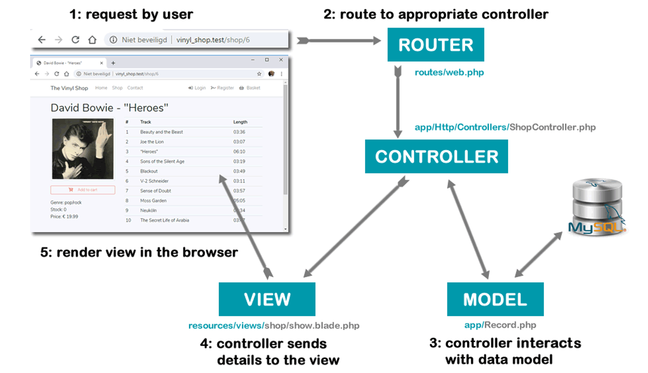
MVC Architecture

Slide 12
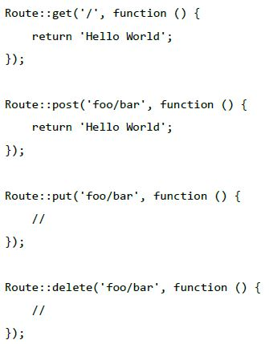
Routing in Laravel
Routing means, route your request to an appropriate controller.
The routes of the application can be defined in routes/web.php file.
Controller play important role between View and Model.
General route Syntax:

Slide 13
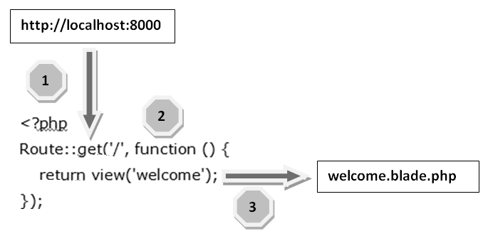
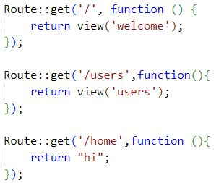
routes/web.php

Slide 14
Routing Parameters
Some times we need to capture the parameters passed with the URL.
To do this, we need to modify the code in web.php
Required Parameters
Optional Parameters
Required Parameters
These parameters must be present in the URL.
For example, if you want to capture the ID from the URL. The sample coding is
Whatever argument that we pass after the root URL (http://localhost:8000/emp/5), it will be stored in $id and we can use that parameter for further processing but here we are simply displaying it.
We can pass it onto view or controller for further processing.
Route :: get ('emp/{id}', function ($id) {
echo 'Employee ID is'. $id; });

Slide 15
Optional Parameters
Many parameters do not remain present within the URL, but the developers had to use them.
Such parameters get indicated by a "?" (question mark sign) following the parameter's name.
The presence of these parameters is not necessary in the URL.
Route :: get (‘emp/{name?}', function ($name = ‘Sandip') {
echo $name; });

Slide 16
Controller
Controller are class based php files
Controllers can group related request handling logic into a single class.
Controller play important role between View and Model.
Controllers directs traffic among the Views and the Models.
Types of Controller
Basic Controller
Simple controller without built-in methods.
Resource Controller
Controller with built-in methods.
Used for CRUD Operations
Creating a Controller
php artisan make : controller <controller-name>
Basic Controller
php artisan make : controller <controller-name> --resource
Resource Controller
The created controller can be seen at app/Http/Controllers.

Slide 17
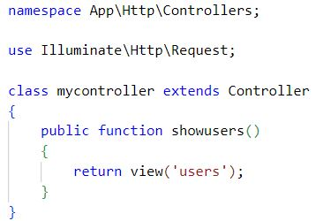
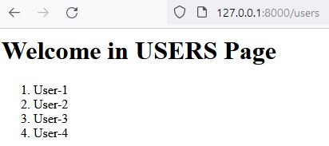
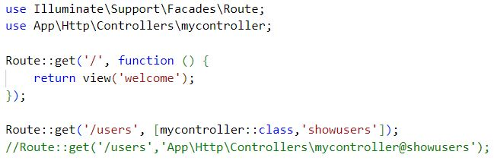
Controller - mycontroller.php
View - users
Call the Controller from routes - web.php

Slide 18
Pass data from a Controller to a View
We can pass data from a controller to a view using various ways.
Using associative array
Controller (UserController.php)
View (profile.blade.php)
namespace App\Http\Controllers;
use Illuminate\Http\Request;
class UserController extends Controller
{
public function showUser()
{
$name = "John Doe";
$email = "john@example.com";
return view('user.profile', [
'name' => $name,
'email' => $email
]);
}}
<html>
<head>
<title>User Profile</title>
</head>
<body>
<h1>Welcome, {{ $name }}</h1>
<p>Your email is: {{ $email }}</p>
</body>
</html>

Slide 19
Pass data from a Controller to a View
Using compact()
public function showUser()
{
$name = “kazi";
$email = “kazi@gmail.com";
return view('your_view_name', compact('name', 'email'));
}
Using with()
public function showUser()
{
return view('your_view_name')
->with('name', 'Aziz')
->with('email', 'aziz@example.com');
}

Slide 20
Blade Template
Blade is Laravel's powerful, lightweight, and simple templating engine.
It allows you to write HTML mixed with dynamic content in a clean, readable syntax using special directives (e.g., @if, @foreach, @extends, etc.).
Blade files use the .blade.php extension and are stored in the resources/views/ directory.
Benefit | Description
Clean Syntax | Easy-to-read directives like @if, @foreach.
Code Reuse | Layout inheritance avoids duplication.
Separation of Concerns | Keeps logic in controllers, display in views.
Security | Auto-escaping for output ({{ }}) prevents XSS.
Extensible | You can define your own custom directives.
Performance | Compiled into plain PHP and cached for speed.

Slide 21
Key Concepts of Blade Template
Template Inheritance
Allows you to define a base layout and extend it in other views.
// layouts/app.blade.php
<html>
<body>
@yield('content')
</body>
</html>
// home.blade.php
@extends('layouts.app')
@section('content')
<p>Welcome to Laravel!</p>
@endsection
@if($user->isAdmin())
<p>Welcome Admin</p>
@elseif($user)
<p>Hello, {{ $user->name }}</p>
@else
<p>Please log in</p>
@endif
@foreach($users as $user)
<li>{{ $user->name }}</li>
@endforeach
Displaying Data
Use {{ $variable }} to safely echo content.
<p>Hello, {{ $name }}</p>
Control Structures
Blade provides clean directives for logic.

Slide 22
Includes
Reuse small parts of a UI (header, footer, etc.)
@include('partials.header')
Components
Reusable UI blocks using <x-component-name /> syntax.
Blade components are stored in resources/views/components.
<x-alert type="success" :message="$msg" />
Loops and Loop Variables
Blade gives $loop object inside loops.
@foreach($users as $user)
{{ $loop->iteration }}. {{ $user->name }}
@endforeach
Comments in Blade
{{-- This is a Blade comment --}}

Slide 23
Artisan
Command line interface for Laravel.
It provides a number of helpful commands for your use while developing your application.
Its like REPL in Node JS.
Listing All Available Commands
To view a list of all available Artisan commands, you may use the list command:
php artisan list
Viewing The Help Screen For A Command
php artisan help migrate
Displaying Your Current Laravel Version
php artisan --version
To start Laravel project
php artisan serve

Slide 24
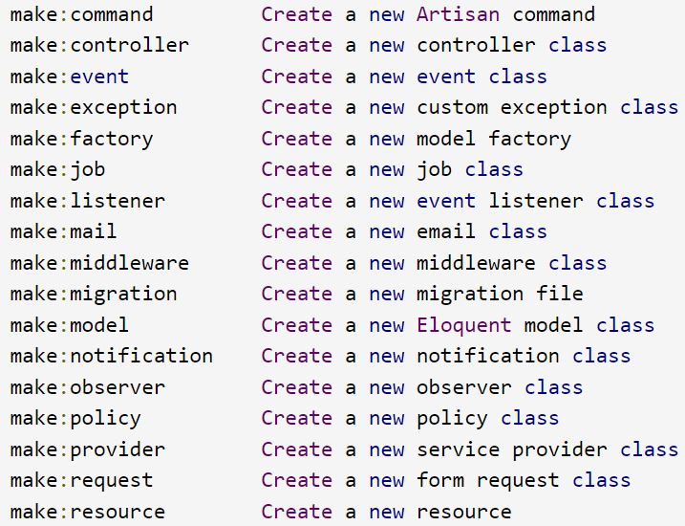
PHP Artisan Commands

Slide 25
Composer
Composer is a dependency manager for a PHP programming language that manages the dependencies of PHP software and required libraries.
In Laravel, the composer is a tool that includes all the dependencies and libraries.
Third-party libraries can be installed easily using composer.
It helps us to manage libraries/packages required for our projects.
Composer is used to managing its dependencies and the dependencies are noted in composer.json file which is placed in the source folder.
Composer runs through the command line.
The main purpose of the composer is to install the dependencies or libraries for an application.
Add packages to your composer.json
composer require firebase/php-jwt
Here , firebase/php-jwt is the name of the Package

Slide 26
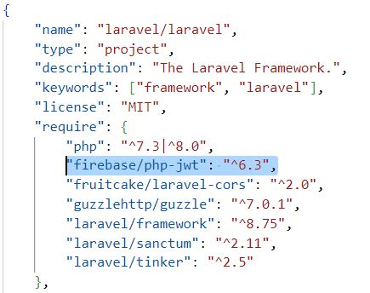
Remove Package from Laravel Application
Use the following command to remove the package from vendor.
This will also update composer.json and composer.lock accordingly.
Syntax : composer remove vendor/package
Example : composer remove firebase/php-jwt
composer remove vendor/package
Composer.json
Updating Packages
composer update monolog/monolog

Slide 27
Forms Handling in LARAVEL
Create your HTML form in a Blade template, ensuring you have the correct method, action (using named routes), and the @csrf directive.
Define a route in your routing files (web.php or api.php) that matches the form's action and HTTP method.
Create a controller method to handle the incoming request.
Access the submitted data using the $request object.
Implement robust validation using $request->validate() to ensure data integrity.
Display validation errors in your Blade template using the $errors object and the @error directive.
Process the valid data and perform necessary actions (e.g., database operations, sending emails).
Optionally redirect the user after successful processing, often with a success message using session flashing.

Slide 28
Create Form View (resources/views/user-form.blade.php)
<html>
<body>
<h2>User Form</h2>
@if(session('success'))
<p style="color: green">{{ session('success') }}</p>
@endif
@if ($errors->any())
<ul style="color: red">
@foreach ($errors->all() as $error)
<li>{{ $error }}</li>
@endforeach
</ul>
@endif
<form method="POST" action="{{ route('user.submit') }}">
@csrf
<label>Name:</label><br><input type="text" name="name"><br><br>
<label>Email:</label><br><input type="email" name="email"><br><br>
<button type="submit">Submit</button>
</form>
</body>
</html>

Slide 29
Create Controller (app/Http/Controllers/UserController.php)
namespace App\Http\Controllers;
use Illuminate\Http\Request;
class UserController extends Controller
{
public function create()
{
return view('user-form');
}
public function store(Request $request)
{
// Simple validation
$request->validate([
'name' => 'required|string',
'email' => 'required|email'
]);
return redirect('/user-form')->with('success', 'Form submitted successfully!');
}
}

Slide 30
Create Routes (routes/web.php)
use Illuminate\Support\Facades\Route;
use App\Http\Controllers\UserController;
Route::get('/user-form', [UserController::class, 'create']);
Route::post('/user-submit', [UserController::class, 'store'])->name('user.submit');
Visit /user-form
Fill in the name and email. Click Submit
You'll see a success message or validation errors

Slide 31
Eloquent ORM in Laravel?
Eloquent ORM (Object-Relational Mapping) is Laravel’s built-in way of interacting with the database using PHP classes (models) instead of writing raw SQL queries.
Each Eloquent model represents a table in the database, and each instance of the model represents a row in that table.
No SQL Required
Eloquent uses a clean, readable syntax to handle CRUD operations without writing SQL.
Example: Inserting Data
$user = new User;
$user->name = 'Alice';
$user->email = 'alice@example.com';
$user->save();
Fetching Data Easily
$users = User::all(); // Get all users
$user = User::find(1); // Find user by ID
$user = User::where('email', 'like', '%gmail.com')->get(); // Filter

Slide 32
Built-in Relationships
Eloquent supports relationships like:
hasOne
hasMany
belongsTo
belongsToMany
// In User.php model
public function posts() {
return $this->hasMany(Post::class);
}
$user = User::find(1);
$posts = $user->posts; // Get all posts by that user
Automatic Timestamps
Eloquent auto-manages created_at and updated_at fields.
Query Builder Integration
You can mix Eloquent with Laravel's fluent query builder for advanced queries.

Slide 33
Benefits of Eloquent ORM
Feature | Benefit
Simple Syntax | Easier and cleaner than raw SQL
Relationship Support | Handles foreign keys & joins automatically
Auto Timestamps | No need to manually manage created/updated dates
Readable Code | Code is expressive and easy to maintain
Laravel Integrated | Works seamlessly with validation, controllers, etc.

